Slide 1
Understanding Desktop Applications
Lesson 5

Slide 2
Objective Domain Matrix
Skills/Concepts | MTA Exam Objectives
Understanding Windows Forms Applications | Understand Windows Forms applications (5.1)
Understanding Console-Based Applications | Understand console-based applications (5.2)
Understanding Windows Services | Understand Windows services (5.3)
Notes:
Tip: Add your own speaker notes here.

Slide 3
Understanding Windows Forms Applications
Windows Forms applications are smart client applications consisting of one or more forms that display a visual interface to the user.
A Windows Form is a visual surface capable of displaying a variety of controls, including text boxes, buttons, and menus.
A control is a distinct user interface element that accepts input from the user or displays output to the user.
Notes:
Tip: Add your own speaker notes here.

Slide 4
Designing a Windows Form
Visual Studio provides a drag-and-drop Windows Forms designer.
Windows Forms includes a large collection of common controls.
For specialized interfaces, you can create a custom-control.
Notes:
Tip: Add your own speaker notes here.

Slide 5
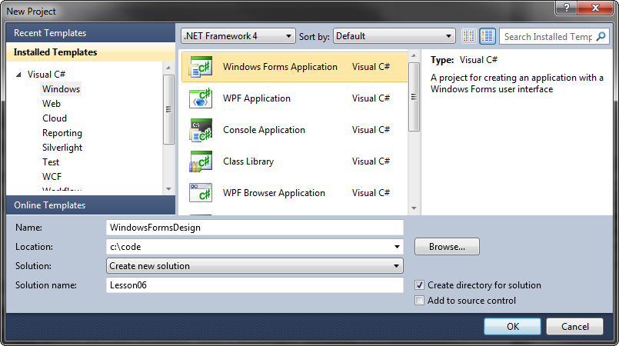
Creating a Windows Form
Create projects based on the Visual Studio’s Windows Forms Application template.
Notes:
Tip: Add your own speaker notes here.

Slide 6
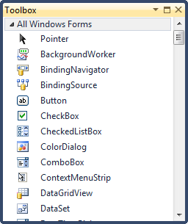
Visual Studio Toolbox
The Visual Studio toolbox provides common controls.

Slide 7
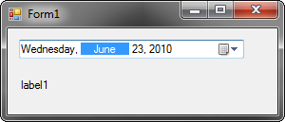
Windows Forms User Interface
You can drag and drop controls from the Toolbox and arrange them on the Windows Forms designer to create the user interface.

Slide 8
Windows Forms Event Model
A form and its components respond to user actions such as keystrokes or mouse movement. These actions are called events.
Much of the code that you write as a Windows Forms developer is directed toward capturing such events and responding.
The Windows Forms event model uses .NET Framework delegates to bind events to their respective event handlers.
Notes:
Tip: Add your own speaker notes here.

Slide 9

Handling Events
Here, ValueChanged is the event of the DateTimePicker control that we want to capture.
A new instance of the delegate of type EventHandler is created and the method dateTimePicker1_ValueChanged is passed to the event handler.
The dateTimePicker1_ValueChanged is the method in which you will write the event-handling code.

Slide 10

Handling Events - Example
The dateTimePicker1_ValueChanged method is invoked when the ValueChanged event is fired on the dateTimePicker1 control.
The parameter of the object type specify the object that raised the event.
The parameter of the EventArgs type provides information about the event.

Slide 11
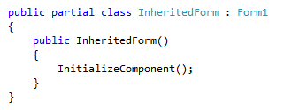
Visual Inheritance
Visual inheritance allows you to reuse existing functionality and layout for Windows Forms.
When inheritance is applied to a Windows Form, it causes the inheritance of all the visual characteristics of a form, such as size, color, and any controls placed on the form.
You can also visually manipulate any of the properties that are inherited from the base class.

Slide 12
Multiple Document Interface (MDI) Applications
Multiple Document Interface (MDI) applications are applications in which multiple child windows reside under a single parent window.
MDI applications allow multiple windows to share a single application menu and toolbar.
With Single document interface (SDI) applications, each window contains its own menu and toolbar.
SDI applications rely on the operating system to provide window management functionality.
To create an MDI application, set the IsMdiContainer property to True.
For the child windows, set the MdiParent property to refer to the parent form.

Slide 13
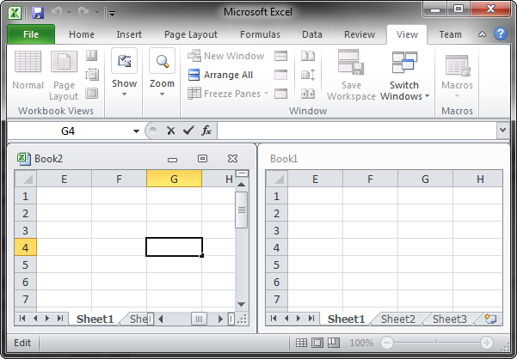
MDI Application Sample

Slide 14
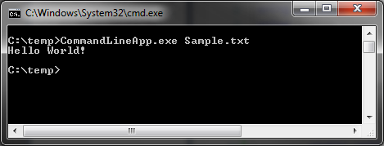
Console-Based Applications
Console-based applications do not have a graphical user interface and use a text-mode console window to interact with the user.
Console applications are best suited for tasks that require minimal or no user interface.

Slide 15
Windows Service Applications
A Windows service is an application that runs in the background and does not have any user interface.
Ideal for creating long-running programs that run in the background and do not directly provide any user interaction.
A Windows service can be started, paused, restarted, and stopped.
A Windows service can also be set to start automatically when the computer is started.
Services play an important role in enterprise application architecture. For example, you can have a service that listens for incoming orders and starts an order-processing workflow whenever an order is received.

Slide 16
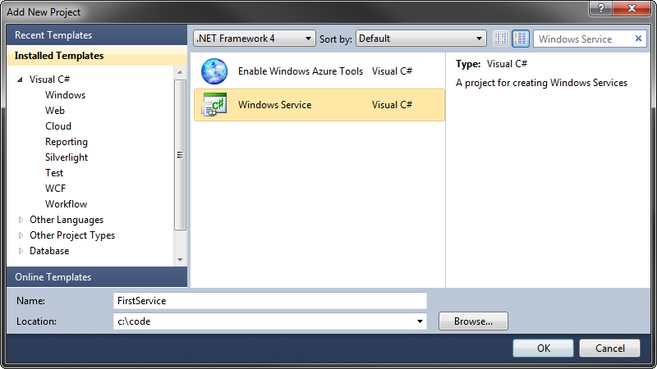
Creating Windows Service Applications
Use the Windows Service project template to create Windows Services.

Slide 17
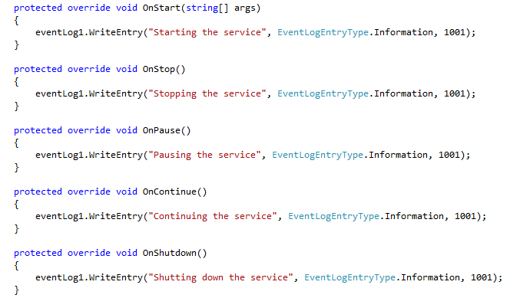
Creating Windows Service Applications
The Windows Services inherits from the ServiceBase class. Override the OnStart, OnStop, OnPause, OnContinue and OnShutdown method to customize service behavior.

Slide 18
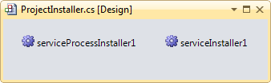
Installing Windows Service Applications
A Windows Service must be installed before use.
The ServiceProcessInstaller class performs installation tasks that are common to all the Windows services in an application.
Setting the login account for the Windows service.
The ServiceInstaller class, on the other hand, performs the installation tasks that are specific to a single Windows service.
setting the ServiceName and StartType.
An executable file that has the code for the service installer classes can be installed by using the command line Installer tool (installutil.exe).

Slide 19
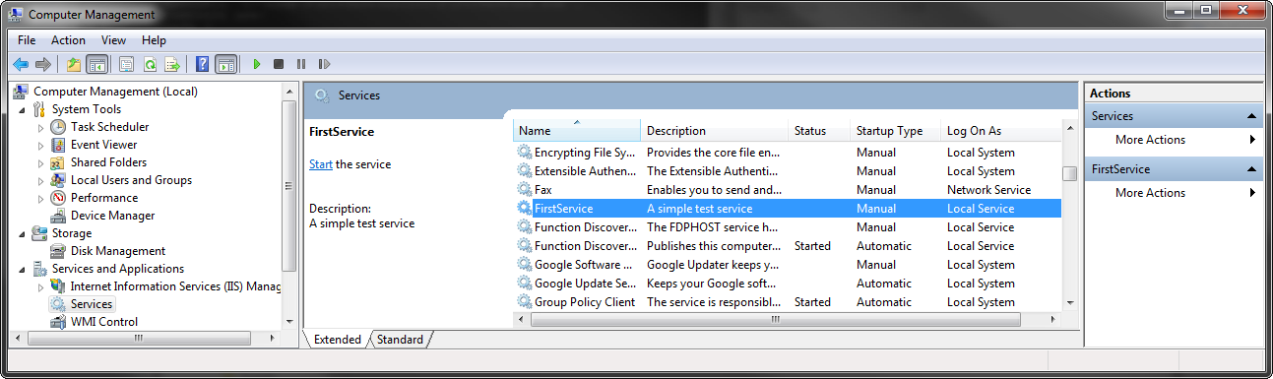
Managing Windows Service Applications
Use the Windows Services tool to start, stop, pause and continue a Windows service.

Slide 20
Recap
Windows Forms Applications
Designing a Windows Form
Windows Forms Event Model
Visual Inheritance
MDI Application vs. SDI Application
Console-Based Applications
Command-line Arguments
Windows Service Applications
Creating a Windows Service

